Slide 1


Phd thesis
Particle Based Modelling of Scrap Handling for Green Steel Production
Notes:
[0:00 – 1:00]
"Good morning, everyone. Today, I am excited to present my research proposal for developing an advanced particle-based modelling framework for optimising scrap handling systems. In the next 15 minutes, I will walk you through the fundamental theory of the Discrete Element Method (DEM), the critical knowledge gaps in EAF scrap feeding, my proposed 4-year methodology, and how my technical background aligns with Tata Steel's operational goals."
Slide notes: keep the opening short and confident; make eye contact; the committee values time management — this deck is timed for exactly 15 minutes of speaking (slides 2–12), with the reference slide [13] as backup.

Slide 2
Agenda
1
Theory of particle-based models (DEM) & conveyor systems
Non-spherical shape representation • contact mechanics • belt / chute / vibratory-feeder kinematics
2
State of the art & knowledge gaps in scrap / EAF modelling
Where the literature stands today — and what it has not solved
3
Methodology, novelty & anticipated challenges
4-year research plan • coarse-graining calibration strategy • project novelty
4
Skills, competencies & personal reflection
Technical toolkit • data integration • experimental validation • industrial collaboration
Particle-Based Modelling of Scrap Handling for Green Steel Production • TU Delft × Tata Steel Netherlands
2
Notes:
[1:00 – 1:45]
"Our agenda today directly addresses the key requirements: First, the core mechanics of DEM applied to conveyor systems; second, the state of the art and literature gaps; third, my explicit research methodology and anticipated challenges; and finally, a personal reflection on my competencies."
Slide notes: the four agenda items map 1:1 to the four topics requested for the interview (see planning.md, Topics 1-4).

Slide 3
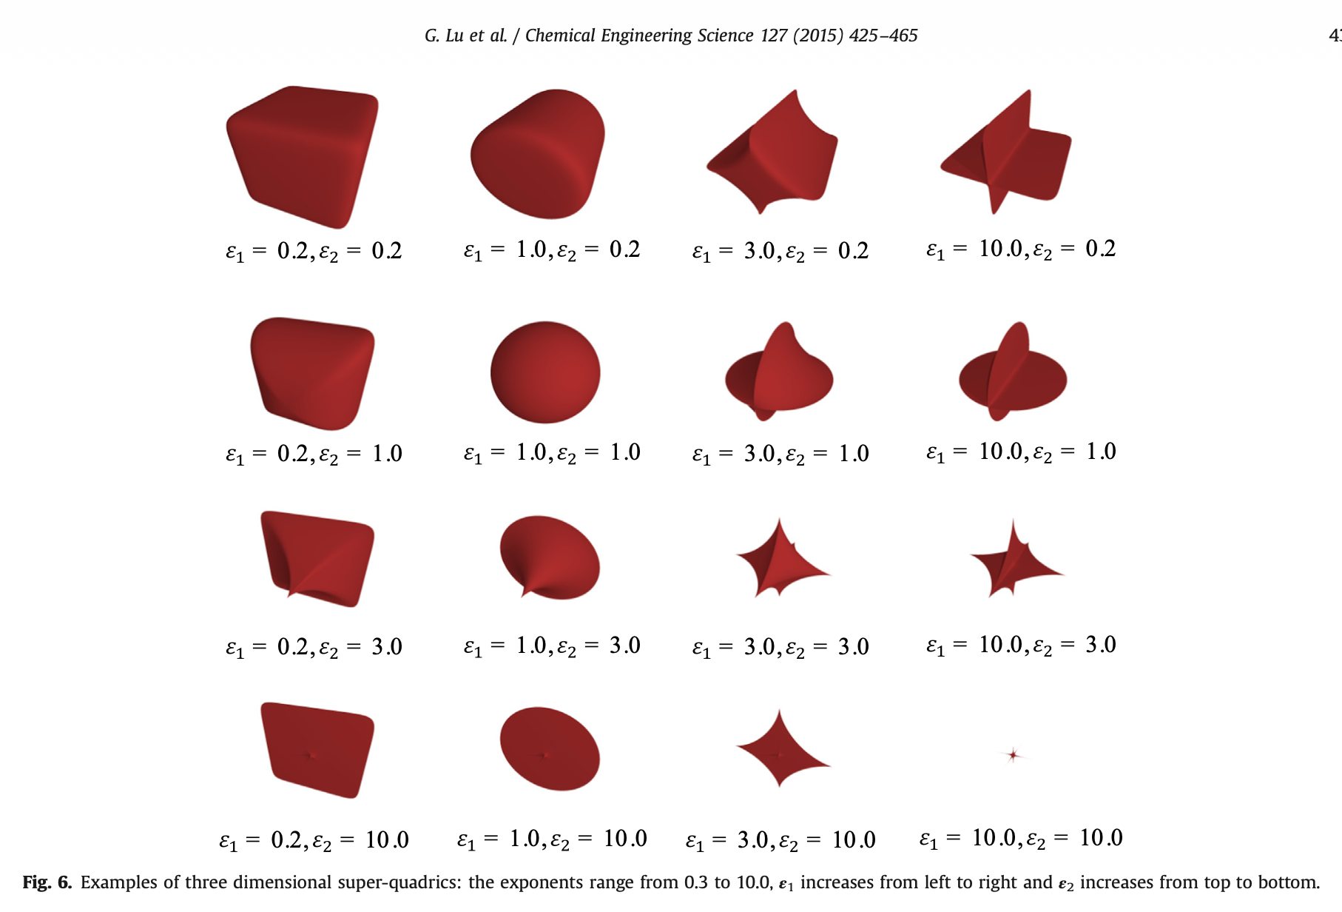
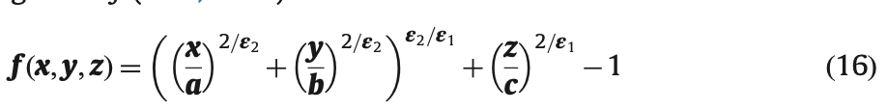
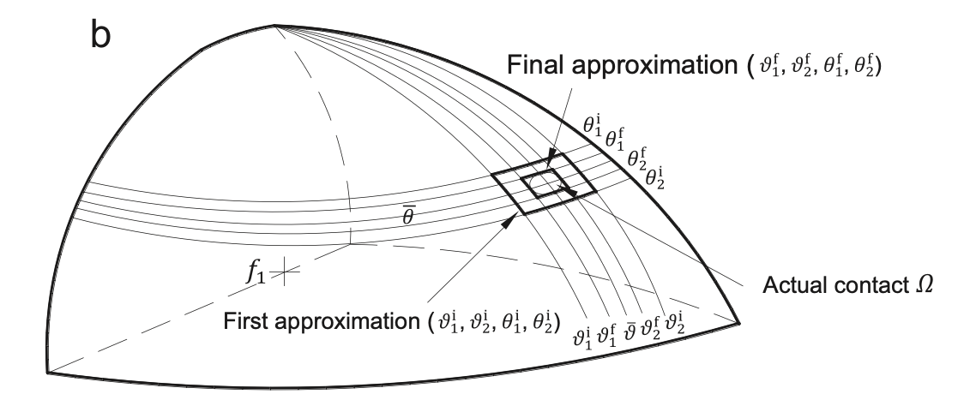
TOPIC 1 — PARTICLE-BASED MODELLING (DEM)
DEM Fundamentals & Particle Shape Representation
• DEM tracks every scrap fragment individually via Newton's laws (Lagrangian); each contact carries a normal force Fn and a tangential force Ft (spring–damper contact model)
• Scrap is never round — shape controls friction, interlocking, bridging and segregation, so spheres alone roll too easily
• Non-spherical shape representation (Lu et al. 2015; Zhong et al. 2016):
– Multi-sphere clusters — robust; reuses sphere–sphere contacts; best proxy for shredded scrap
– Polyhedra — angular rock/scrap; common-plane contact; many contact cases to classify
– Super-quadrics — smooth, regular shapes; ε₁, ε₂ vary roundness → blockiness continuously
– Voxel / digitised — arbitrary 3D-scanned shapes; grid-resolution limited
– Bonded particles — add fracture & deformation
• Key trade-off: contact detection alone can consume >80% of the computation time
Fig. 6 — 3D super-quadric family: ε₁ (left→right), ε₂ (top→bottom) (Lu et al., 2015)
Fig. 4b — approximation of the actual contact region Ω between two super-quadrics (Lu et al., 2015)
Eq. (16) — 3D super-quadric implicit function; ε₁ = ε₂ = 1 gives an ellipsoid (Lu et al., 2015)
Notes:
[1:45 – 3:15]
"Let's begin with the fundamental physics. The Discrete Element Method operates by tracking individual particles via Newton's laws of motion. In industrial scrap yards, particles are highly non-spherical. To capture realistic friction and interlocking behaviour, I will employ Multi-Sphere models or Polyhedral elements. While spheres are computationally cheap, they roll too easily. We must account for the high aspect ratios and sharp edges typical of steel scrap to accurately simulate structural bridging and interlocking."
Slide notes: right column shows (top) the 3D super-quadric shape family from Lu et al. (2015) Fig. 6 — blockiness parameters ε1/ε2 sweep from rounded to blocky; (bottom) their implicit equation (16) and Fig. 4b contact-region approximation. Emphasise: for scrap we will mainly use multi-sphere clusters built from 3D scans (robust + fast contact detection), with super-quadrics/polyhedra where smooth/angular fidelity matters. Contact detection can take >80% of CPU time, so the choice of representation is a compute decision, not just a physics decision.

Slide 4
TOPIC 1 — PARTICLE-BASED MODELLING (DEM) & CONVEYOR SYSTEMS
Conveyor Belts & Vibratory Feeders: Mechanics at the Boundary
Belt conveyor
chevron patterned belt • wall friction • belt velocity
Transfer chute
impact plate • hood • rock box • build-up & blockage
Vibratory feeder
inertial vibration: frequency, amplitude, inclination
EAF infeed
continuous charging into the furnace
Rossow & Coetzee (2021) — chevron belt + transfer chute
Powder Technol. 391:77–96
• First DEM study of a chevron-patterned belt with impact plate, hood and rock box; 3D-laser-scanned particles modelled as 3/5/10-sphere multi-sphere “clumps”
• Validated against high-speed footage: mass flow ≤5.4% error, impact velocity <6.1%, impact-wall force <17%
• Maximum particle up-scaling factor 1.6 (≤10% error) — DEM beat the analytical model in accuracy
Schefler & Coetzee (2023) — cohesive belt discharge
Minerals 13(12):1501
• Wet-and-sticky material discharging from belt onto an inclined impact plate: build-up profile, peak impact force and residual weight reproduced with <15% error using upscaled particles
• Max acceptable scale factor is a geometric property of the bulk measure of interest — not of the physical particle size
• Higher cohesion → thicker discharge stream & taller build-up → higher allowable scale factor
You et al. (2018) — vibration sorting of non-spherical particles
Powder Technol. (2018)
• DEM of an inclined vibrating plate: non-spherical particles as super-ellipsoids, mixed 1:1 with spheres
• Vibration frequency & amplitude control the velocity distribution and discharge sequence of the mixture
• Effective separation when (2πf)²A ≈ 1.5g — a practical design rule for vibratory feeders
Xiao et al. (2024) — measuring real scrap feeding
CSAE 2024 (ACM)
• Vision-based speed measurement of scrap on an inertial vibratory conveyor (SuperPoint feature-point extraction & matching)
• Works despite heterogeneous scrap types, sizes and stacking — no object tracking needed
• On-site application: measured speed curve matches the horizontal-vibrator frequency curve — an industrial validation pathway for our models
Particle-Based Modelling of Scrap Handling for Green Steel Production • TU Delft × Tata Steel Netherlands
4
Notes:
[3:15 – 4:45]
"When bulk scrap transfers from a conveyor belt to an EAF infeed chute, it undergoes severe dynamic stress. By solving the contact force equations at moving boundaries, our model will simulate wall friction, boundary velocity distributions, and impact energy. On vibratory feeders, the frequency and amplitude of the bed dictate particle acceleration. DEM allows us to isolate how different frequencies cause structural segregation, ensuring we can predict which particles discharge first and where the mechanical wear on the hopper liners will be most severe."
Slide notes: cite Rossow & Coetzee (chevron belt + chute, high-speed validation, upscaling limit 1.6) and Schefler & Coetzee (cohesive discharge, <15% error) as the mature modelling base; You et al. as the vibration-segregation evidence; Xiao et al. as proof that real scrap-feeding measurement exists today (vision-based) — our models can be validated against it.

Slide 5
TOPIC 2 — CURRENT STATE OF THE ART & KNOWLEDGE GAPS
The Frontier of Research: Where the Literature Stands
Reference | System & method | What it establishes | Limitation for EAF scrap
Lu et al. (2015) — Chem. Eng. Sci. 127 (review) | Non-spherical DEM review: polyhedra, super-quadrics, multi-sphere, voxel, bonded | Shape representation + contact detection; contact detection can cost >80% of CPU time | No scrap-specific benchmark; generic granular systems
Zhong et al. (2016) — Powder Technol. 300 (review) | DEM / CFD-DEM review: AVM vs. immersed-family coupling | No single best method; hybrid averaged + resolved strategies | Generic particulate flows, not scrap handling
Ahmed et al. (2026) — Powder Technol. (Tata Steel IJmuiden) | Industrial BF charging: skip car → top hopper, actual plant geometry | Plant-faithful DEM; ferrous-burden segregation lowers throat permeability | Uniform BF burden (ore/sinter) — not heterogeneous EAF scrap
Rossow & Coetzee (2021) — Powder Technol. 391 | Chevron belt + transfer chute, multi-sphere particles, high-speed validation | Quantified DEM accuracy & upscaling limits (≤1.6×) | Lab-scale corn grains, non-cohesive
Schefler & Coetzee (2023) — Minerals 13:1501 | Cohesive material: belt → inclined impact plate | Upscaled cohesive discharge: force & residual mass <15% error | Lab-scale sand; single material
You et al. (2018) — Powder Technol. | Inclined vibrating plate, super-ellipsoids + spheres | Frequency/amplitude → sorting & segregation; (2πf)²A ≈ 1.5g | Lab-scale idealised shapes
Chen et al. (2022) — Metall. Mater. Trans. B | 3D CFD of AC-EAF scrap melting, dual-cell + stack, NLMK 150-t EAF | Melting, arc & burner physics well resolved and industrially validated | Scrap enters as a lumped input — infeed dynamics not resolved
Li, Provatas & Irons (2008) — AISTech | Phase-field modelling of late melting in the EAF heel | “Steel iceberg” formation dominates late melting; size, preheat & convection effects | Post-charge physics — scrap assumed already in the furnace
Pattern: DEM for conveyors/chutes is mature and validated — EAF CFD is mature and validated — the mechanical charging stage in between is the weak link.
Particle-Based Modelling of Scrap Handling for Green Steel Production • TU Delft × Tata Steel Netherlands
5
Notes:
[4:45 – 6:15]
"Reviewing the current state of the art shows a significant disconnect. Excellent DEM models exist for blast furnace charging — such as research calibrated at Tata Steel IJmuiden — but these focus on uniform materials like iron ore pellets. Conversely, current EAF literature focuses heavily on the thermodynamic and CFD chemical melting inside the furnace, completely neglecting the mechanical bulk flow of raw scrap before it enters the liquid bath. There is a profound lack of physical particle tracking models for heterogeneous scrap recipes."
Slide notes: table walks top→bottom: reviews (Lu 2015, Zhong 2016) → industrial BF charging at Tata Steel IJmuiden (Ahmed et al. 2026) → conveyor/chute DEM validation studies (Rossow 2021, Schefler 2023, You 2018) → EAF melting models (Chen 2022, Li 2008). Close on the bottom strip: both halves are mature, the interface is not.

Slide 6
TOPIC 2 — CURRENT STATE OF THE ART & KNOWLEDGE GAPS
The Key Industry Knowledge Gaps
GAP 1 Material heterogeneity
Heavy melting scrap (bundles up to metres, dense, low porosity) vs. shredded & baled scrap (cm-scale, light, porous, high surface area). Multi-material recipes combine very different shape, size, bulk density and chemistry — no particle-level model yet resolves the whole stream.
GAP 2 Real-time co-segregation in continuous feeding
How does heterogeneity segregate during vibratory feeding and chute transfer? If fine scrap blocks the chute or heavy bundles drop unpredictably, the charge layers unevenly → thermal imbalances, energy spikes and late melting (“steel icebergs”) in the EAF.
Handling ↔ furnace coupling is missing
Conveyor/chute DEM is mature; EAF CFD is mature; the interface between them is not yet built.
Industrial validation of charging dynamics is sparse
Scrap flow in a running EAF is hard to observe directly; most DEM studies are validated on related lab materials.
Multiphysics at the charge surface
Infeed scrap moves from mechanical handling to heating, oxidation, re-soldering and collapse — current models treat these separately.
Bottom line from the literature: treat scrap infeed as a coupled granular-transport problem — DEM particle mechanics for conveyor / chute / charging, handed off to a furnace model that resolves packing-dependent heat transfer and melting.
Particle-Based Modelling of Scrap Handling for Green Steel Production • TU Delft × Tata Steel Netherlands
6
Notes:
[6:15 – 7:30]
"This brings us to the two key knowledge gaps this PhD will bridge. First, how do we model a bulk material stream that is structurally heterogeneous, ranging from lightweight shredded metal to massive, dense heavy melting scrap bundles? Second, how does this heterogeneity trigger material segregation during continuous charging? If fine scrap blocks the chute or heavy bundles drop unpredictably, it causes thermal imbalances and massive energy spikes in the EAF."
Slide notes: the three secondary gaps come from the literature review (see LeapSpace summary in the repo): coupling of handling & furnace physics; realistic scrap shape & packing; charge dynamics during delivery; validation with industrial scrap; multiphysics at the charge surface. Tie Gap 2 to Li et al. 2008: late/iceberg melting is exactly what happens when the charge arrives wrong.

Slide 7
TOPIC 3 — METHODOLOGY, NOVELTY & ANTICIPATED CHALLENGES
Research Plan: The 4-Year Roadmap
Y1 — Model development
Y2 — Industrial calibration
Y3 — Optimisation scenarios
Y4 — Plant implementation
• Non-spherical DEM of scrap: multi-sphere & super-quadric proxies from 3D scans
• Baseline shape characterisation: size, shape, bulk density, porosity
• Lab calibration: angle of repose, drop & draw-down tests
• Tata Steel NL plant data: feeders, chutes, recipes
• Build the virtual material library (bale / shredded / HMS)
• High-speed video & load-cell validation; upscaling limits at industrial scale
• Multi-material recipe simulations in real plant geometry
• Segregation & discharge-sequence optimisation (which scrap goes first)
• Coupling with melting model: charge layering, HBI + scrap interaction
• Digital twin of the EAF infeed chain
• Actionable operating rules for plant engineers
• Wear & energy-reduction recommendations; dissemination & PhD defence
Guiding principle: every year ends in a validated artefact the plant can use — not just a simulation.
Particle-Based Modelling of Scrap Handling for Green Steel Production • TU Delft × Tata Steel Netherlands
7
Notes:
[7:30 – 9:00]
"To address these gaps, my proposed 4-year research plan is structured systematically. Year 1 focuses on mathematical code development and baseline shape characterisation. Year 2 will integrate industrial data sets from Tata Steel Netherlands to calibrate our virtual materials. Year 3 will focus on simulating various charging recipes and sequence optimisation. Year 4 will translate these computational models into practical, actionable rules for industrial plant engineers."
Slide notes: Y1 = Lu/Zhong shape representations + lab calibration suite; Y2 = Tata Steel NL data + validation (Rossow-style high-speed footage, Xiao-style vision measurement); Y3 = recipe optimisation incl. segregation; Y4 = digital twin + recommendations. Emphasise the artefact-per-year discipline.

Slide 8
TOPIC 3 — METHODOLOGY, NOVELTY & ANTICIPATED CHALLENGES
Calibration Strategy & the Coarse-Graining Dilemma
STEP 1 Physical experiments
Angle of repose • drop / bounce (COR) • draw-down • feeder mass flow • high-speed video
STEP 2 Parameter optimisation loop
Friction, rolling resistance, restitution, cohesion; PSD & multi-sphere fitting against bulk response
STEP 3 Calibrated DEM engine
Altair EDEM / Ansys Rocky (commercial) • LIGGGHTS / MFIX-DEM (open source)
STEP 4 Industrial validation
Chute flow, build-up, impact force & mass balance vs. plant data (Tata Steel NL)
The coarse-graining dilemma
• Steel scrap piles span millimetres (shreds) to metres (HMS bundles) — simulating every fragment is computationally impossible
• Strategy: cluster small particles into representative numerical equivalents — volume-equivalent diameter, mass-matched multi-sphere clusters
• The virtual pile must match the real pile: angle of repose, stream thickness, build-up profile, discharge rate
• Calibrate rolling friction & shape until the virtual scrap behaves like the physical material at every scale
What the literature says about upscaling
• Rossow & Coetzee (2021): scale factor ≤ 1.6 keeps errors ≤ 10% (build-up −9.2%, discharge −5.6%); wall effects negligible when container / particle ≥ 8–10 : 1
• Schefler & Coetzee (2023): the maximum scale factor is a geometric property of the bulk measure of interest — and it increases with cohesion
• Implication: calibrate per industrial quantity of interest (build-up, force, flow rate), not per particle
• Kryszak et al. (2020) / Kozicki & Tejchman (2005): contact force spectra and grid-free methods give the validation toolbox for impact & damage
Particle-Based Modelling of Scrap Handling for Green Steel Production • TU Delft × Tata Steel Netherlands
8
Notes:
[9:00 – 10:30]
"The greatest anticipated challenge in this project is scale and computation time. Simulating millions of unique scrap fragments down to the millimetre scale is computationally impossible. My strategy involves coarse-graining / upscaling methodologies. We will cluster smaller particles into representative numerical equivalents. We will then perform laboratory-scale calibration experiments — such as angle of repose and pouring tests — to adjust rolling friction coefficients until the virtual scrap pile matches the behaviour of the real physical material."
Slide notes: the 4-step loop is the core methodological claim. Quote the numbers: Rossow & Coetzee max scale factor 1.6 (errors ≤10%); Schefler & Coetzee — scale limit is geometric to the measured quantity; container/particle ≥ 8–10:1 for negligible wall effects. This is the 'industrially calibrated simulation' that separates this project from idealised spherical-particle work.

Slide 9
TOPIC 3 — METHODOLOGY, NOVELTY & ANTICIPATED CHALLENGES
Project Novelty & Expected Deliverables
Core novelty: a multi-scale, multi-property characterisation model that transforms raw Tata Steel data into a dynamic digital twin of EAF scrap infeed — multi-material recipes (bale, shredded, heavy melting scrap) moving through real industrial handling equipment.
Digital twin of EAF infeed
Optimised discharge sequences
Reduced energy & wear
• Scrap treated as a variable, uncertain feedstock — not a fixed input
• Multi-property particles: size, shape, bulk density, porosity, chemical heterogeneity (Cu, Cr …)
• Continuous chain: vibratory feeder → chute → charging, in real plant geometry
• Predict which scrap discharges first under given vibration frequency / amplitude
• Avoid chute blockage, bridging and stagnant zones
• Smooth, continuous feeding — stable layers at the charge surface
• Fewer late-melting “steel icebergs” → shorter tapping delays (Li et al., 2008)
• Predict impact forces & liner wear on chutes and feeders
• Cheaper scrap recipes tested virtually before plant trials (HBI + scrap layering)
Particle-Based Modelling of Scrap Handling for Green Steel Production • TU Delft × Tata Steel Netherlands
9
Notes:
[10:30 – 11:45]
"The true core novelty of this PhD project is the creation of an industrially validated Digital Twin for multi-property scrap flows. We are moving away from treating raw materials as uniform rocks. Instead, this framework will allow Tata Steel to test new, cheaper scrap recipes virtually, optimising discharge sequences to guarantee smooth, continuous feeding. The direct outcomes will be a measurable reduction in mechanical wear on handling infrastructure and optimised energy efficiency during EAF startup phases."
Slide notes: novelty = multi-scale + multi-property + industrial (three words to remember). Deliverables map to the interview's 'industrial value' expectation: twin (asset), sequence optimisation (process gain), energy/wear (money).

Slide 10
TOPIC 4 — REFLECTION ON PERSONAL SKILLS & COMPETENCIES
Technical Alignment with Project Requirements
Project requirement | My toolkit
Non-spherical DEM modelling — shape representation, contact detection, force & torque models | Numerical programming in Python / C++; multi-sphere & super-quadric particle modelling; hands-on with Altair EDEM, Ansys Rocky, LIGGGHTS and MFIX-DEM (open source)
Data integration — plant data into a digital twin | Experience handling large data arrays; Python data pipelines (pandas / NumPy); statistical composition & uncertainty estimation for scrap recipes
Experimental validation — physical boundary tests | Angle-of-repose, drop/bounce and draw-down tests; feeder mass-flow tracking; high-speed video & PIV analysis of flow trajectories
Industrial collaboration — from academia to the plant floor | Translating dense academic results into clear, operational value for plant operations; structured project management of a 4-year industrial PhD
Simulation strategy: commercial engines (EDEM, Rocky) for fast industrial delivery + open-source codes (LIGGGHTS, MFIX-DEM) for custom contact models, CFD-DEM coupling and cost control — validated the same way: physical experiments → bulk response → plant data.
Particle-Based Modelling of Scrap Handling for Green Steel Production • TU Delft × Tata Steel Netherlands
10
Notes:
[11:45 – 13:15]
"Why am I the right candidate for this specific project? My academic training has provided me with a robust foundation in granular physics, continuum mechanics, and numerical programming. I have practical experience handling large data arrays and translating raw physical phenomena into structural code. Furthermore, I am deeply familiar with modern engineering simulation frameworks and possess the hands-on laboratory discipline required to design and execute validation experiments that will make our virtual models reliable."
Slide notes: be ready to name the exact tools you have touched (EDEM/Rocky/LIGGGHTS/MFIX-DEM) and the exact experiments you can run (AOR, drop, draw-down, mass flow). The open-source angle shows cost awareness for a 4-year industrial PhD.

Slide 11
TOPIC 4 — REFLECTION ON PERSONAL SKILLS & COMPETENCIES
Communication & Collaborative Mindset
TU Delft — Academic research
• DEM / CFD-DEM theory for non-spherical particles
• Rigorous validation science: lab experiments, uncertainty, upscaling
• Publication track record (international conferences & journals)
Tata Steel Netherlands — Industry
• IJmuiden plant data, access & operational constraints
• HBI + scrap recipes for green (hydrogen-based) steel production
• Plant engineers as co-developers of the digital twin
THIS PHD PROJECT
particle-based digital twin of scrap handling
I pride myself on being able to translate dense academic data into clear, operational value for plant operations.
I am eager to collaborate directly with industrial engineers in the Netherlands — gathering on-site data, co-designing validation campaigns, and ensuring the doctoral research delivers practical, bottom-line improvements to the steelmaking process.
Particle-Based Modelling of Scrap Handling for Green Steel Production • TU Delft × Tata Steel Netherlands
11
Notes:
[13:15 – 14:15]
"Beyond technical software skills, a project backed by Tata Steel requires strong project management and cross-functional communication. I pride myself on being able to translate dense academic data into clear, operational value for plant operations. I am eager to collaborate directly with industrial engineers in the Netherlands, gathering on-site data and ensuring that my doctoral research delivers highly practical, bottom-line improvements to the steelmaking process."
Slide notes: this is a values slide, not a CV. Name-drop the IJmuiden site and the green-steel context (HBI + scrap, hydrogen-based route) to show you know what the partner is building.

Slide 12
CLOSING
Conclusion & Q&A
Theory
DEM with realistic non-spherical representation (multi-sphere / super-quadric / polyhedra) is the right tool for scrap handling — shape is physics, not decoration.
Gap
Charging/infeed is the weak link: conveyor DEM and EAF melting CFD are both mature; the mechanical, heterogeneous, real-time charging stage is not yet modelled.
Plan
Coarse-graining + industrial calibration turns the gap into a validated digital twin of EAF infeed — optimised sequences, less wear, less energy.
Developing the next generation of particle models for sustainable, efficient EAF steel production.
Thank you for your time — I welcome your questions.
Your Name • TU Delft • email@tu.nl
Particle-Based Modelling of Scrap Handling for Green Steel Production • TU Delft × Tata Steel Netherlands
12
Notes:
[14:15 – 15:00]
"In conclusion, this project represents a vital step toward making continuous EAF furnace feeding more predictable, energy-efficient, and physically stable. By mastering non-spherical particle mechanics, bridging the literature gap in scrap handling, and applying rigorous coarse-graining calibration, this research will provide invaluable tools for Tata Steel Netherlands. Thank you for your time, and I welcome any questions you may have."
Anticipated questions to prepare: (1) Why multi-sphere instead of polyhedra/voxels for scrap? → contact-detection cost >80% CPU, robustness, existing EDEM support. (2) How do you validate at industrial scale? → high-speed video, load cells, vision-based feeder speed (Xiao et al.), mass balance. (3) What if upscaling breaks? → per-quantity scale limits (Rossow/Schefler), hybrid AVM+IFM-style strategy. (4) HBI relevance to Tata's green steel route.

Slide 13
SUPPORTING LITERATURE
References
[1] Lu G., Third J.R., Müller C.R. (2015). Discrete element models for non-spherical particle systems: from theoretical developments to applications. Chemical Engineering Science 127: 425–465.
[2] Zhong W., Yu A., Liu X., Tong Z., Zhang H. (2016). DEM/CFD-DEM modelling of non-spherical particulate systems: theoretical developments and applications. Powder Technology 300: 109–127.
[3] Rossow J., Coetzee C.J. (2021). Discrete element modelling of a chevron patterned conveyor belt and a transfer chute. Powder Technology 391: 77–96.
[4] Schefler O.C., Coetzee C.J. (2023). Discrete element modelling of a bulk cohesive material discharging from a conveyor belt onto an impact plate. Minerals 13(12): 1501.
[5] You Y., Liu M., Ma H., Xu L., Liu B., Shao Y., Tang Y., Zhao Y. (2018). Investigation of the vibration sorting of non-spherical particles based on DEM simulation. Powder Technology. doi:10.1016/j.powtec.2017.11.002.
[6] Xiao X., Zhong X., Ma M., Wu X. (2024). A visual based algorithm for measuring the speed of scrap metal vibration feeding. CSAE 2024 (ACM). doi:10.1145/3704814.3704817.
[7] Chen Y., Ryan S., Silaen A.K., Zhou C.Q. (2022). Simulation of scrap melting process in an AC electric arc furnace: CFD model development and experimental validation. Metallurgical and Materials Transactions B 53: 3256–3272.
[8] Li J., Provatas N., Irons G.A. (2008). Modelling of late melting of scrap in an EAF. AISTech 2008, Irons A8046.
[9] Kryszak D., Bartoszewicz A., Szufa S., Piersa P., Obraniak A., Olejnik T.P. (2020). Modelling of transport of loose products with the use of the non-grid method of discrete elements (DEM). Processes 8(11): 1489.
[10] Garg R., Galvin J., Li T., Pannala S. (2012). Documentation of open-source MFIX-DEM software for gas-solids flows. National Energy Technology Laboratory / Oak Ridge National Laboratory.
[11] Kozicki J., Tejchman J. (2005). Application of a cellular automaton to simulations of granular flow in silos. Granular Matter 7: 45–54.
[12] Ahmed H., Pang Y., Adema A., et al. (2026). Industrial-scale DEM modelling of segregation in the blast furnace charging system (Tata Steel IJmuiden). Powder Technology.
[13] Guo D., Irons G.A. (2008). Modelling of steel scrap movement. Applied Mathematical Modelling. doi:10.1016/j.apm.2007.06.037.
[14] Ugarte O., Li J., Haeberle J., et al. (2024). CFD modelling of HBI/scrap melting in industrial EAF and the impact of charge layering on melting performance. Materials 17(21): 5139.
Particle-Based Modelling of Scrap Handling for Green Steel Production • TU Delft × Tata Steel Netherlands
13
Notes:
Reference list — no speaking time. References [1]–[11] have full PDFs in the 'papers/particles-based models' folder of the project repository; [12]–[14] are the additional state-of-the-art sources from the literature plan (planning.md).

